Slide 1

Introduction to Management Strategy Evaluation (MSE)
Philosophy, Concepts, Terminology and Process
Tom Carruthers
tom@bluematterscience.com
Snapper – Grouper Advisory Panel Meeting
19 October 2022

Slide 2
Contents
What is MSE?
How does an MSE differ from a stock assessment?
What does an MSE process look like?

Slide 3
Contents
What is MSE?
How does an MSE differ from a stock assessment?
What does an MSE process look like?

Slide 4
A fishery system
Fishery
Enforcement
Data
Population Assessment & Management Rules

Slide 5
Why?
Fishery
Enforcement
Data
Population Assessment & Management Rules

Slide 6
Why?
Fishery
Enforcement
Data
Population Assessment & Management Rules

Slide 7
Why?
Fishery
Data
Enforcement
Population Assessment & Management Rules

Slide 8
For most fisheries, management decision making could benefit from a more coherent strategy, and increased transparency and accountability.
But when you consider the options, there are good reasons why achieving this has been difficult…

Slide 9



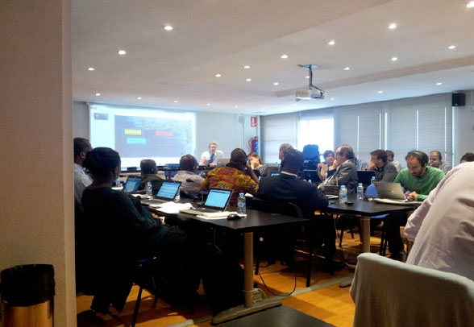
Test by experiment

Slide 10

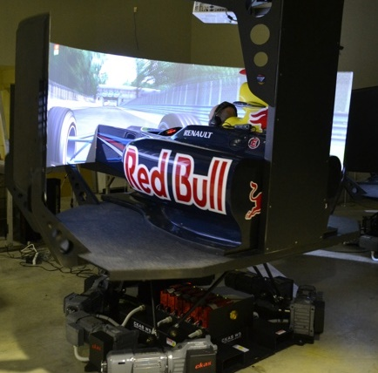
Test by simulation

Slide 11
Test by simulation: the MSE approach
Fishery
Enforcement
Data
Population Assessment & Management Rules

Slide 12
Test by simulation: the MSE approach
Operating model
Enforcement
Data
Population Assessment & Management Rules

Slide 13
Test by simulation: the MSE approach
Operating model
Enforcement
Observation model
Population Assessment & Management Rules

Slide 14
Test by simulation: the MSE approach
Operating model
Enforcement
Observation model
Management Procedure

Slide 15
Test by simulation: the MSE approach
Operating model
Implementation model
Observation model
Management Procedure

Slide 16
Test by simulation: the MSE approach
Operating model
Implementation model
Observation model
Management Procedure
“Harvest strategy”

Slide 17
Test by simulation: the MSE approach
Operating model (OM)
Implementation model
Management Procedure (MP)
Observation model
“Management strategy”

Slide 18
Test by simulation: the MSE approach
Operating model
Implementation model
Observation model
Management Procedure
(Stock assessment + “Harvest control rule”)

Slide 19
Test by simulation: the MSE approach
Operating model
Implementation model
Observation model
Management Procedure

Slide 20
Test by simulation: the MSE approach
Operating model (OM)
Implementation model
Observation model
Management Procedure (MP)

Slide 21
Test by simulation: the MSE approach
Dynamics estimated from assessment OM#1
Implementation model
Observation model
Index-based MP
MP#1

Slide 22
Test by simulation: the MSE approach
Projection year: 2021
Dynamics estimated from assessment OM#1
Implementation model
Observation model
Index-based MP
MP#1

Slide 23
Test by simulation: the MSE approach
Projection year: 2021
Dynamics estimated from assessment OM#1
Implementation model
Observation model
Index-based MP
MP#1

Slide 24
Test by simulation: the MSE approach
Projection year: 2021
Dynamics estimated from assessment OM#1
Implementation model
Observation model
Index-based MP
MP#1

Slide 25
Test by simulation: the MSE approach
Projection year: 2021
Dynamics estimated from assessment OM#1
Implementation model
Observation model
Index-based MP
MP#1

Slide 26
Test by simulation: the MSE approach
Projection year: 2022
Dynamics estimated from assessment OM#1
Implementation model
Observation model
Index-based MP
MP#1

Slide 27
Test by simulation: the MSE approach
Projection year: 2022
Dynamics estimated from assessment OM#1
Implementation model
Observation model
Index-based MP
MP#1

Slide 28
Test by simulation: the MSE approach
Projection year: 2022
Dynamics estimated from assessment OM#1
Implementation model
Observation model
Index-based MP
MP#1

Slide 29
Test by simulation: the MSE approach
Projection year: 2022
Dynamics estimated from assessment OM#1
Implementation model
Observation model
Index-based MP
MP#1

Slide 30
Test by simulation: the MSE approach
Dynamics estimated from assessment OM#1
Catch
Catch
Implementation model
Now 2021 2022 2023 2024 2025
Observation model
Biomass
Biomass
Index-based MP
MP#1
Now 2021 2022 2023 2024 2025
Future year

Slide 31
Test by simulation: the MSE approach
Dynamics estimated from assessment OM#1
Catch
Catch
Implementation model
Now 2021 2022 2023 2024 2025
Observation model
Biomass
Biomass
Index-based MP
MP#1
Now 2021 2022 2023 2024 2025
Future year
Year

Slide 32
Test by simulation: the MSE approach
Dynamics estimated from assessment OM#1
Catch
Catch
Implementation model
Now 2021 2022 2023 2024 2025
Observation model
Biomass
Biomass
Index-based MP
MP#1
Now 2021 2022 2023 2024 2025
Future year
Year

Slide 33
Test by simulation: the MSE approach
Dynamics estimated from assessment OM#1
Catch
Catch
Implementation model
Now 2021 2022 2023 2024 2025
Observation model
Biomass
Biomass
Index-based MP
MP#1
Now 2021 2022 2023 2024 2025
Future year
Year

Slide 34
Test by simulation: the MSE approach
Dynamics estimated from assessment OM#1
Catch
Catch
Implementation model
Now 2021 2022 2023 2024 2025
Observation model
Biomass
Biomass
Index-based MP
MP#1
Now 2021 2022 2023 2024 2025
Future year
Year

Slide 35
Test by simulation: the MSE approach
Index-based MP
New index-mean length MP
Dynamics estimated from assessment OM#1
Catch
Catch
Implementation model
Now 2021 2022 2023 2024 2025
Observation model
Biomass
Biomass
New index- mean length MP
MP#2
Now 2021 2022 2023 2024 2025
Future year
Year

Slide 36
Test by simulation: the MSE approach
Index-based MP
New index-mean length MP
New 2 - index MP
Dynamics estimated from assessment OM#1
Catch
Catch
Implementation model
Now 2021 2022 2023 2024 2025
Observation model
Biomass
Biomass
New 2-index MP
MP#3
Now 2021 2022 2023 2024 2025
Future year
Year

Slide 37
Test by simulation: the MSE approach
Index-based MP
New index-mean length MP
New 2 - index MP
As OM#1 but with less discard mortality
Catch
Catch
Implementation model
Now 2021 2022 2023 2024 2025
Observation model
“Closed-loop simulation”
Biomass
Biomass
New 2-index MP
MP#3
Now 2021 2022 2023 2024 2025
Future year
Year

Slide 38
A brief history of using models to test management ideas
Early 1980s: Adaptive Management (Walters, Hilborn)
Late 1980s: South Africa anchovy / sardines (Bergh & Butterworth 1987)
International Whaling Commission – Management Strategies for potential commercial catch and actual strike limits for subsistence whaling (Kirkwood, Punt and Donovan 2007)
1990s: Cape hake & rock lobster (Radermeyer et al. 2008)
1998 ICES Symposium on Confronting Uncertainty in the Evaluation and Implementation of Fisheries-Management Systems
2000s: CCSBT to select a management strategy for southern bluefin tuna (Kurota et al. 2010 2010s: recently horse mackerel

Slide 39
Today MSE is widely applied
By-catch management of seabirds (Tuck 2011).
Australian Southern and Eastern Scalefish and Shark Fishery (Punt et al. 2002; Wayte and Klaer 2010; Little et al. 2011)
Queensland spanner crab (Dichmont and Brown 2010),
The Northern Prawn Fishery (Dichmont et al. 2008, 2013)
Southern rock lobster (Punt et al. 2012a)
Tasmanian abalone fishery (Haddon and Helidoniotis 2013).
Southern rock lobster off New Zealand (Starr et al. 1997; Breen and Kim 2006).
In North America, northern subpopulation of Pacific sardine (PFMC 1998)
Sablefish off British Columbia (Cox and Kronlund 2008),
West Greenland halibut (Butterworth and Rademeyer 2010; NAFO 2010) and pollock (Rademeyer and Butterworth 2011).
Tristan rock lobster (Johnston and Butterworth 2013, 2014).
San Francisco Bay herring (Valencia 2019)

Slide 40
Questions about the concept of closed-loop simulation

Slide 41
Contents
What is MSE?
How does an MSE differ from a stock assessment?
What does an MSE process look like?

Slide 42
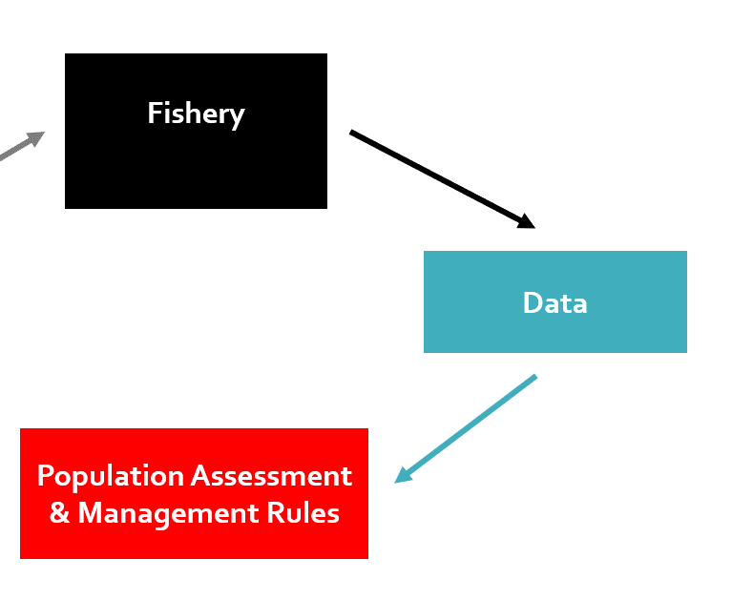
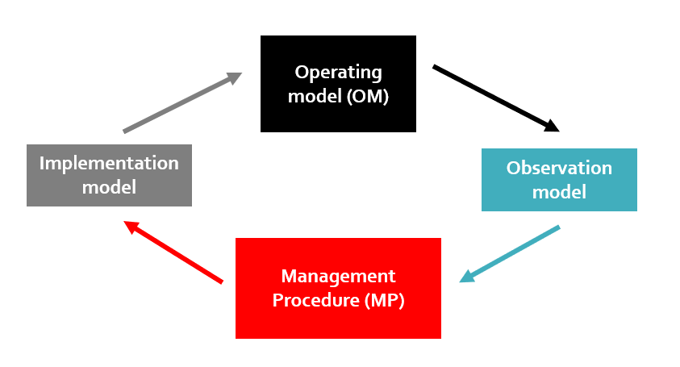
1.2 The difference between stock assessment and MSE
Stock assessment
MSE

Slide 43


Stock assessment does not tell us much about expected management performance!
NASA test pilot Crazy person

Slide 44
MSE vs Stock Assessment
Stock assessment: Data goes in - advice comes out. Sound familiar?
Yes, when used to provide advice, a stock assessment is part of a management procedure!
When simulation tested, typical stock assessments are often:
not very good at estimating scale (overall size of the stock)
sensitive to alternative plausible assumptions
often over-parameterized (too complex for the data and assumptions)
numerically unstable (advice can vary widely due to chance)
incapable of representing potentially important system uncertainties
Stock assessments can provide a precarious basis for decision making where data sources are conflicting and system dynamics are not relatively certain.

Slide 45




There may be many plausible scenarios for the real system dynamics (stock assessment estimates are uncertain)
But we can have confidence in the management procedure because we have tested it across all of those scenarios

Slide 46
MSE vs Stock Assessment: Objective
Stock assessment
Provides management advice (e.g. a TAC – but we don’t know how reliable this advice is)
MSE
Identifies a robust way to provide management advice - a management procedure that can achieve management performance objectives.

Slide 47
MSE vs Stock Assessment: Emphasis
Stock assessment
Provide advice (TAC) from the single best possible interpretation of the available data.
Scientific accuracy.
MSE
Find a management procedure that can meet performance objectives and is robust to various interpretations of the available data.
Account for a range of plausible fishery scenarios.
Provide confidence in the adopted management approach.
Management performance and robustness to scientific uncertainties.

Slide 48
MSE vs Stock Assessment: Expected performance of the management approach
Stock assessment
Unknown
MSE
Tested by simulation and quantifiable by metrics relating to yield and biomass, for example.

Slide 49
MSE vs Stock Assessment: Uncertainty
Stock assessment
Uses sensitivity analyses to investigate uncertainty in the estimated fishery system.
MSE
Uses multiple scenarios for the ‘true’ fishery system (operating models) as a testbed for management procedures.

Slide 50
MSE vs Stock Assessment: Communication of uncertainty
Stock assessment
Focuses on variance in model estimates (e.g. stock depletion) and advice (e.g. a TAC) within the assessment model and among sensitivity analyses.
MSE
Focuses on uncertainties that matter: which OM uncertainty affects management performance and the selection of management procedures?
MP ranking is often invariant to dynamics that strongly impact TAC advice – i.e. some uncertainties affect all MPs equally.

Slide 51
MSE vs Stock Assessment: Generation of Advice
Stock assessment
Management advice arises from models that are often quite complex and difficult to interpret for a wider range of stakeholders (sometimes only understandable to the assessment team and the reviewers).
Managers may often diverge from assessment-based advice in response to broader indicators such as catch rates.
MSE
Advice can be derived from very simple rules (e.g. higher TAC if index above a target level, TAC lower if index below a target level) or even be prescriptive such as a gear configuration, seasonal closure, size limit or a fixed level of fishing effort (e.g. days at sea).
The advice provided by the MP is generally followed.

Slide 52
MSE vs Stock Assessment: Robustness
Stock assessment
Unknown robustness to uncertainties.
MSE
Uses multiple scenarios for the ‘true’ fishery dynamics (OMs) as a testing platform for management procedures.
If an MP is adopted we can know its strengths and weaknesses (which system properties to look out for).
Confidence in management approach.

Slide 53
MSE vs Stock Assessment: Complexity of the process
Stock assessment
Depends on the data, fishery and assessment approach. The complexity exists in the model that generates advice (essentially the management procedure itself).
MSE
Generally more arduous in terms of identifying operating models, performance metrics and candidate MPs.
High technical demands in terms of making an MSE framework
TAC advice is calculated by an MP that is generally much easier to understand than a stock assessment.

Slide 54
MSE vs Stock Assessment: Stakeholder Involvement
Stock assessment
Stakeholders often feel like observers to the process and unable to relate assessment outputs to their objectives.
MSE
Stakeholders are central to the process. Since performance objectives are at the heart of MP selection it is vital that stakeholders communicate what are good and bad outcomes for them.
Stakeholders often also provide candidate MPs for testing

Slide 55
MSE vs Stock Assessment: Transparency
Stock assessment
Since management performance of assessments is unknown, it is not clear how decisions regarding modelling and data were made. For example, when we changed to model X that uses data Y, what was the expected benefit in terms of yield and biomass?
MSE
At the end of the MSE process if an MP is adopted it will be clear why the MP was chosen, what performance managers were aiming for / avoiding, and what performance trade-offs were involved.

Slide 56
Questions about assessments vs MSE

Slide 57
Contents
What is MSE?
How does an MSE differ from a stock assessment?
What does an MSE process look like?

Slide 58
MSE process 1
A clear problem statement
What is the objective? What is the MSE intended to solve? For example:
High degree of uncertainty in fishery dynamics leading to uncertain stock assessment outputs
Multi-species management impacts not accounted for by single-species management
Unknown robustness of current assessment-control rule to ecosystem changes or climate impacts

Slide 59



MSE process 2
Three principal groups:
Oversight (strategists)
Steers the process, sets objectives, communicates with decision makers, organizes the timeline and stages of the process including deadlines, guillotines, decision points and meetings.
User (drivers)
Stakeholders, scientists, managers interested in MSE results and the testing of candidate MPs.
Experts in various aspects of the fishery (e.g. growth, movement, fishing efficiency, datasets)
Technical (engineers)
Work on mathematical, statistical and computer programming tasks required to get the MSE implemented.

Slide 60
MSE process 3
Closely following Punt et al. 2014 (MSE best practices)
Performance metrics
OM structure
Data
System uncertainties
How should successful management be measured?
What are the necessary features of an operating model for this stock?
What data do we have to inform models that can characterize these uncertainties?
What are the key system uncertainties that a Management Procedure should be robust to?
Phase 1

Slide 61
MSE process 3
Performance metrics
OM structure
Data
Operating Models
System uncertainties
Fitting Operating Models to data (conditioning)
Constructing a range of OMs that span primary uncertainties (‘Reference set’) and secondary uncertainties (‘Robustness set’)
Phase 1 Phase 2

Slide 62
MSE process 3
Performance metrics
OM structure
Data
Operating Models
OM selection / weighting
System uncertainties
Can operating models be weighted according to plausibility?
What types of management procedure should be considered – what management levers are available (TACs, effort control, size limits, discarding devices etc.)?
What data will be collected in the future?
Candidate MPs
Phase 1 Phase 2 Phase 3

Slide 63

MSE process 3
Closed-loop simulation
Operating model
Performance metrics
Implementation model
Observation model
OM structure
Management Procedure
Data
Operating Models
OM selection / weighting
Testing / MP selection
System uncertainties
How should performance metrics be used to select a Management Procedure?
Candidate MPs
Phase 1 Phase 2 Phase 3 Phase 4

Slide 64
MSE process 3
Closed-loop simulation
Operating model
Performance metrics
Implementation model
Observation model
OM structure
Management Procedure
Data
Operating Models
OM selection / weighting
Testing / MP selection
System uncertainties
MP Adopted
Candidate MPs
Phase 1 Phase 2 Phase 3 Phase 4 Phase 5

Slide 65
MSE process 3
Closed-loop simulation
Operating model
Performance metrics
Implementation model
Observation model
OM structure
Management Procedure
Data
Operating Models
OM selection / weighting
Testing / MP selection
System uncertainties
Exceptional Circumstances
MP Adopted
Candidate MPs
Phase 1 Phase 2 Phase 3 Phase 4 Phase 5

Slide 66
Initial priorities
What is good management performance in this context?
What current uncertainties in the system should management be robust to?
What management levers are available and what data can be used in the future to make management recommendations?
Closed-loop simulation
Operating model
Performance metrics
Implementation model
Observation model
OM structure
Management Procedure
Data
Operating Models
OM selection / weighting
Testing / MP selection
System uncertainties
Exceptional Circumstances
MP Adopted
Candidate MPs
Phase 1 Phase 2 Phase 3 Phase 4 Phase 5

Slide 67
Questions about MSE process and priorities

Slide 68
Contents
What is MSE?
How does an MSE differ from a stock assessment?
What does an MSE process look like?
Further questions / discussion?

